Slide 1


Dept. of CS&E ( DATA SCIENCE)
Adichunchanagiri Institute of Technology Chikkamagaluru - 577102
Mini Project – Proposal Seminar On
‘‘AI-Driven hospital queue and bed availability tracking system’’
Presented By,
Group-09
Ganesh H (4AI23CD018)
Manasa Y K (4AI23CD027)
Megha G K (4AI23CD028)
Nilesh Kumar Jha (4AI23CD032)
Under the Guidance Of,
Asst Prof. Gagana Deepa J
Dept of Data Science AIT,CKM

Slide 2
AGENDA
About the Project
Motivation
Existing System
Proposed System
Problem Statement
Tools and Technology
Expected Outcomes

Slide 3
ABOUT THE PROJECT
AI-powered system for hospital queue & bed tracking.
Real-time dashboard for admins and staffs to monitor occupancy of bed and queue status.
Integrated AI for booking tokens & waiting time updates.

Slide 4
MOTIVATION
Long queues & overcrowding causes delays.
Patients are often un-aware of waiting times or bed availability.
Manual tracking leads to errors & mismanagement.
COVID-19 highlighted the need for real-time monitoring.

Slide 5
EXISTING SYSTEM V/S PROPOSED SYSTEM
EXISTING SYSTEM | PROPOSED SYSTEM
Manual or semi-automated queue systems. | Queue system with AI, automatically tracks and updates.
No real-time tracking. | Real time bed/ICU and queue updations.
Patients must rely on staffs. | AI bot to assist patients.
crowded queue ,long waiting hours. | AI prediction to reduce waiting time.
Low visibility for patients. | Transparent updates accessible to all.

Slide 6
PROBLEM STATEMENT
To design an AI-driven web app that addresses the issues like long queues, overcrowded waiting areas, and inefficient patient flow management in hospitals. Hospitals currently lack a unified platform to provide real-time updates on bed and ICU availability, causing delays and miscommunication. This system focuses on addressing these challenges to improve transparency and overall efficiency in hospital operations.

Slide 7
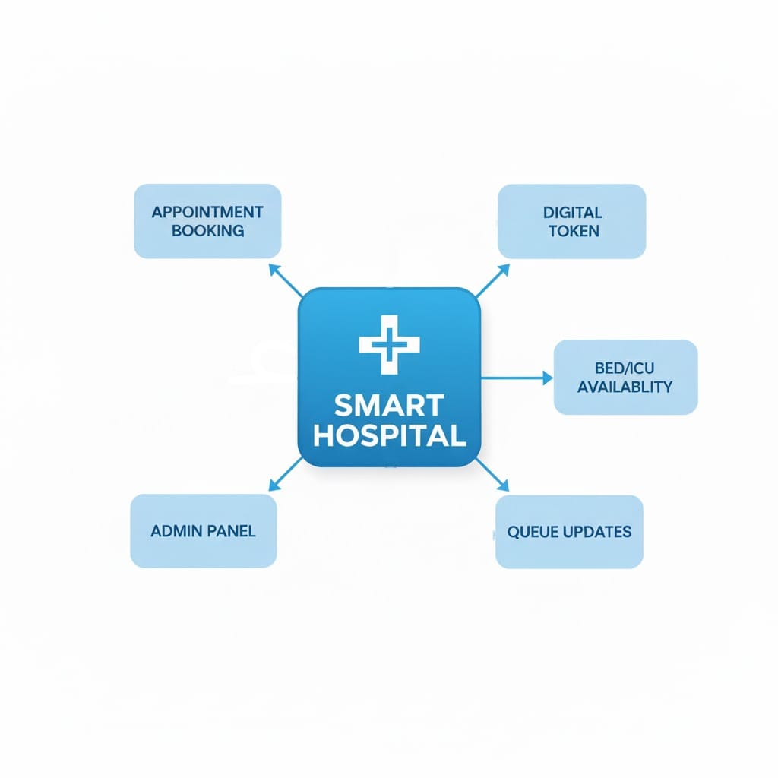
PROPOSED SYSTEM
Web application for managing queues & beds.
Online token booking (unified with offline tokens).
Integrated AI for :
Current waiting time
Queue position and updates
Online appointment booking
Admin panel for staffs for real-time updates.

Slide 8
WORKING FLOW
User/Patient
Web interface
Hospitals
Digital tokens
Queries about queue
Waiting time/queue status
Book appointments
Bed/ICU availability
Occupied
available
Admin/staffs
Manages database
Real time data Updations

Slide 9
TOOLS AND TECHNOLOGY
Frontend : HTML, CSS (for interface design)
Backend : Django (Python)
Database : SQLite
AI components : Gemini API, Python (TensorFlow)
Authentication & Security: Django Authorization (built-in user login system)
Version Control: Git / GitHub

Slide 10
EXPECTED OUTCOMES
Unified online & offline queue system.
Real-time bed & ICU tracking.
AI-based waiting time and queue position updates.
Online appointment booking.
Admin dashboard for real time updates.

Slide 11
Questions?

